Slide 1
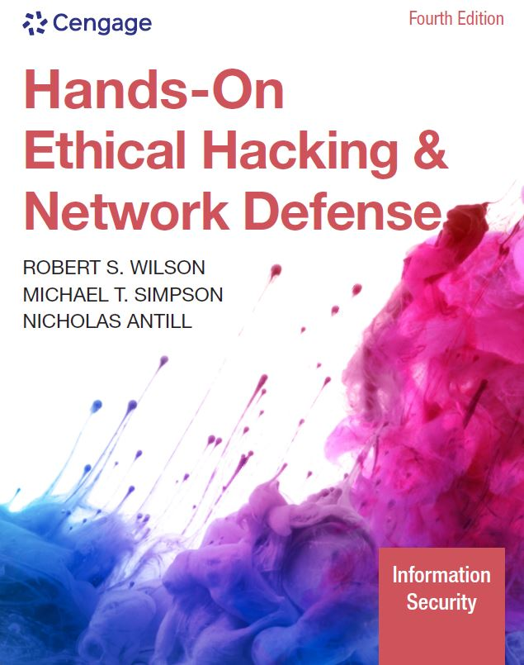
Hands-On Ethical Hacking and Network Defense, Edition 4
Module 12: Cryptography
Simpson, Antill, Wilson, Hands-On Ethical Hacking and Network Defense, 4th Edition. © 2023 Cengage. All Rights Reserved. May not be scanned, copied or duplicated, or posted to a publicly accessible website, in whole or in part.

Slide 2
Module Objectives
By the end of this module, you should be able to:
Summarize the history and principles of cryptography
Describe symmetric and asymmetric encryption algorithms
Explain public key infrastructure (PKI)
Describe possible attacks on cryptosystems
Compare hashing algorithms and how they ensure data integrity

Slide 3
Understanding Cryptography Basics
Cryptography
Process of converting plaintext into ciphertext
Plaintext: Readable text
Ciphertext: Unreadable or encrypted text
Used to hide data from unauthorized users
Decryption
Process of converting ciphertext back to plaintext

Slide 4
History of Cryptography (1 of 2)
Has been around for thousands of years
Some Egyptian hieroglyphics were encrypted
Parts of the Book of Jeremiah were written using a cipher
Substitution cipher
Replaces one letter with another letter
Based on a key
Example: Julius Caesar’s cipher
Shifted each letter of the alphabet three positions

Slide 5
History of Cryptography (2 of 2)
Cryptanalysis
Study of breaking encryption algorithms
When a new encryption algorithm is developed, cryptanalysis is used to ensure that breaking the code is impossible
Or it would take so much time and so many resources that the attempt would be impractical
When cryptanalysis is feasible with a reasonable amount of computing power:
An attack on the algorithm is deemed “practical”
And the algorithm is considered weak

Slide 6
The War Machines (1 of 2)
Enigma machine
Most famous encryption device
Developed by Arthur Scherbius
Used by Germans during World War II
Most books on cryptography discuss this device
Enigma substituted each letter typed by the operator
Substitutions were computed using a key and set of switches or rotors
When the message was completely encrypted, it was transmitted over the airwaves
Code was broken first by Polish cryptographers, and then the British and Americans
The machine British and American cryptologists used for breaking the code was called the Bombe

Slide 7
The War Machines (2 of 2)
The Purple Machine
Developed by Japanese during World War II
Used techniques discovered by Herbert O. Yardley
Code was broken by William Frederick Friedman
Known as the Father of U.S. Cryptanalysis
Steganography
Process of hiding data in plain view in pictures, graphics, or text

Slide 8
Understanding Symmetric and Asymmetric Algorithms (1 of 2)
Encryption algorithm
Mathematical function or program that works with a key
The algorithm’s strength and key’s secrecy determine the security of the data
Key
Sequence of random bits generated from a range of allowable values called a keyspace, which is contained in the algorithm
The larger the keyspace, the more keys that can be created
The more random keys that can be created, the more difficult it is for hackers to guess the key that was used to encrypt the data
Cryptosystem
Converts between plaintext and ciphertext
No matter how strong the algorithm or how large the keyspace, if the key isn’t protected, an attacker can decrypt the message

Slide 9
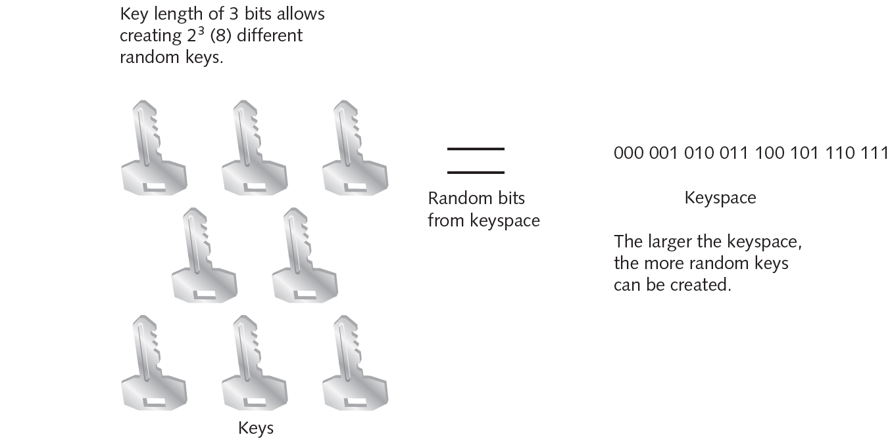
Understanding Symmetric and Asymmetric Algorithms (2 of 2)
Source: Cengage Learning
Figure 12-1 Selecting random keys from a keyspace

Slide 10
Symmetric, Asymmetric, and Hashing Algorithms
Type of algorithm | Description
Symmetric | Uses a single key to encrypt and decrypt data. Both the sender and receiver must agree on the key before data is transmitted. Symmetric algorithms support confidentiality but not authentication and nonrepudiation (covered later in “Asymmetric Algorithms”). However, they’re at least 1000 times faster than asymmetric algorithms.
Asymmetric | Uses two keys: one to encrypt data and one to decrypt data. Asymmetric algorithms support authentication and nonrepudiation but are slower than symmetric algorithms. Asymmetric algorithms are also known as public key cryptography.
Hashing | Used for verification. Hashing takes a variable-length input and converts it to a fixed-length output string called a hash value or message digest.

Slide 11
Symmetric Algorithms (1 of 8)
Cryptosystems using symmetric algorithms have one key that encrypts and decrypts data
Advantages
Faster than asymmetric algorithms
Difficult to break if a large key size is used
Only one key needed to encrypt and decrypt data
Disadvantages
Require each pair of users to have a unique secret key
Makes key management a challenge
Difficult to deliver keys without risk of theft
Does not support authentication and nonrepudiation for users

Slide 12
Symmetric Algorithms (2 of 8)
Types of symmetric algorithms
Stream ciphers
Operate on plaintext one bit at a time
Block ciphers
Operate on blocks of bits
These blocks are used as input to mathematical functions that perform substitution and transposition of the bits
Data Encryption Standard (D E S)
The National Institute of Standards and Technology (N I S T):
Wanted a means of protecting sensitive but unclassified data
Invited vendors in 1970 to submit encryption algorithms

Slide 13
Symmetric Algorithms (3 of 8)
Data Encryption Standard (cont’d)
IBM proposed Lucifer
A 128-bit encryption algorithm
The National Security Agency (NSA) reduced key size to 64 bits and created Data Encryption Algorithm (DEA)
1988: NSA thought the standard was at risk of being broken
Because of its longevity and the increasing power of computers
1998: A computer system was designed to break the encryption key in only three days

Slide 14
Symmetric Algorithms (4 of 8)
Triple Data Encryption Standard (3 D E S)
Served as a quick fix for D E S vulnerabilities
Performed the original D E S computation three times with different keys
Made it much stronger than D E S
Takes longer to encrypt and decrypt data than D E S

Slide 15
Symmetric Algorithms (5 of 8)
Advanced Encryption Standard
N I S T put out request for a new encryption standard
Required submissions for a symmetric block cipher capable of supporting 128-, 192-, and 256-bit keys
Five finalists
Rijndael (winner)
MARS
RC6
Serpent
Twofish

Slide 16
Symmetric Algorithms (6 of 8)
International Data Encryption Algorithm
Block cipher that operates on 64-bit blocks of plaintext
Uses 128-bit key
Developed by Xuejia Lai and James Massey
Designed to work more efficiently in computers used at home and in businesses
Free for noncommercial use

Slide 17
Symmetric Algorithms (7 of 8)
Blowfish
Block cipher that operates on 64-bit blocks of plaintext
Key length can be as large as 448 bits
Developed as a public-domain algorithm by Bruce Schneier
RC4
Most widely used stream cipher
Used in WEP wireless encryption
Finding the key with air-cracking programs is easy
Created by Ronald L. Rivest in 1987 for RSA Security

Slide 18
Symmetric Algorithms (8 of 8)
RC5
Block cipher
Operates on different block sizes: 32, 64, and 128
Key size can reach 2048 bits
Created by Ronald L. Rivest in 1994 for RSA Security

Slide 19
Asymmetric Algorithms (1 of 6)
Use two mathematically related keys
Data encrypted with one key can only be decrypted with the other
Also called public key cryptography
Public key: Openly available
Private key: Secret key known only by the key owner
Different ways to encrypt a message with asymmetric algorithms, depending on whether the goal is to provide authentication and nonrepudiation
Authentication verifies that the sender or receiver (or both) is who they claim to be
Nonrepudiation ensures that the sender or the receiver cannot deny sending or receiving the message

Slide 20
Asymmetric Algorithms (2 of 6)
How it works
User A encrypts a message with a private key and sends it to User B
User B decrypts the message with User A’s public key
A user’s private and public keys are mathematically related
If confidentiality is a major concern for User A:
User A encrypts a message with User B’s public key
User A can assure User B about the authenticity of the message by encrypting the message with their private key

Slide 21
Asymmetric Algorithms (3 of 6)
RSA
Published in 1978 by Ronald L. Rivest, Adi Shamir, and Leonard M. Adleman
First algorithm used for both encryption and digital signing
Still widely used, particularly in e-commerce
Many browsers using the Transport Layer Security (TLS) protocol use the RSA algorithm
Based on the difficulty of factoring large numbers
Uses a one-way function to generate a key
A mathematical formula that is easy to compute in one direction
Difficult or impossible to compute in the opposite direction

Slide 22
Asymmetric Algorithms (4 of 6)
Diffie-Hellman
Developed by Whitfield Diffie and Martin Hellman
Does not provide encryption
Used to establish one secret key shared between two parties
Each party generates a shared key based on a mathematical key–agreement relationship
If a key is intercepted during transmission, network is vulnerable to attack
With a method of sharing a secret key, users can secure their electronic communication without fear of interception

Slide 23
Asymmetric Algorithms (5 of 6)
Elliptic curve cryptography (ECC)
Used for:
Encryption
Digital signatures and key exchange
Efficient algorithm that requires only few resources
Memory
Disk space
Bandwidth
Good candidate for wireless devices and cell phones

Slide 24
Asymmetric Algorithms (6 of 6)
ElGamal
Used to:
Generate keys
Encrypt data
Create digital signatures
Developed by Taher Elgamal in 1985
Uses discrete logarithm problems that are complex to solve
Solving a discrete logarithm problem can take many years and require CPU-intensive operations

Slide 25
Digital Signatures (1 of 6)
Asymmetric algorithms
Enable a public key to decrypt a message encrypted with a private key or vice versa
A public key can only decrypt a message encrypted with the corresponding private key

Slide 26
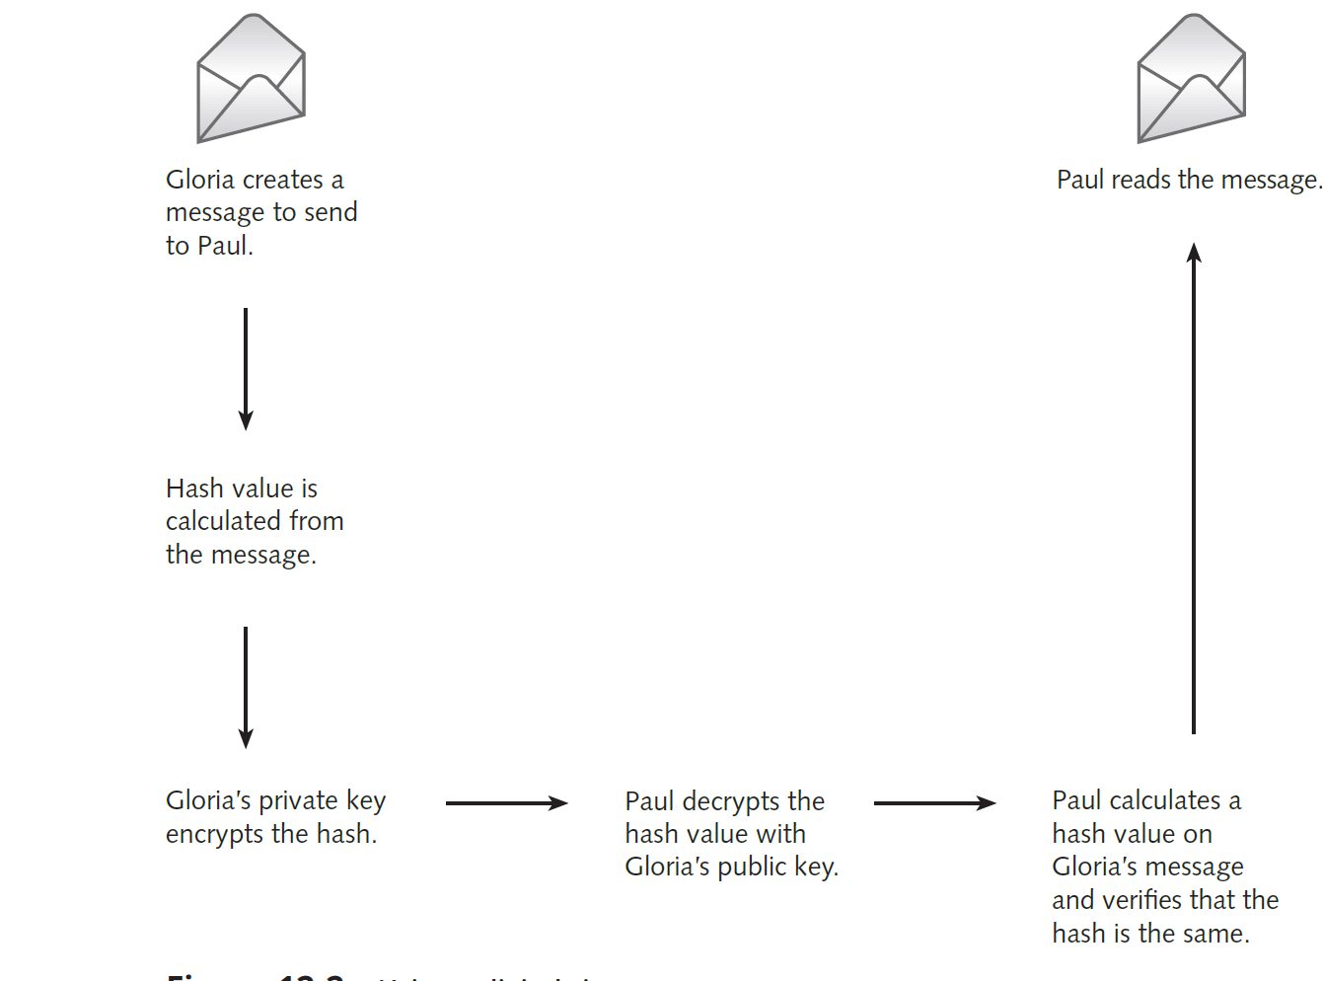
Digital Signatures (2 of 6)
Source: Cengage Learning
Figure 12-2 Using a digital signature

Slide 27
Digital Signatures (3 of 6)
Digital Signature Standard
Established by N I S T in 1991
To ensure that digital signatures can be verified
Federal government requirements
RSA and Digital Signature Algorithm (DSA) must be used for all digital signatures
Hashing algorithm must be used to ensure message integrity
N I S T requires using Secure Hash Algorithm (SHA)

Slide 28
Digital Signatures (4 of 6)
Pretty Good Privacy (PGP)
Developed by Phil Zimmerman as a free email encryption program
Allowed typical users to encrypt email messages
Zimmerman was almost arrested for this innovation in the mid-1990s
Any kind of “unbreakable” encryption was seen as a weapon
Sharing it was compared with selling arms to the enemy
The Internet standard for PGP messages is now called OpenPGP
Uses certificates similar to those in PKI
Does not use a centralized CA
Verification of CA is not as efficient as PKI

Slide 29
Digital Signatures (5 of 6)
Pretty Good Privacy (cont’d)
Algorithms supported by OpenPGP:
AES
IDEA
RSA
DSA
SHA

Slide 30
Digital Signatures (6 of 6)
Secure Multipurpose Internet Mail Extension (S/MIME)
Another public key encryption standard
Used to encrypt and digitally sign email
Can encrypt email messages containing attachments
Can use PKI certificates for authentication
Widely used for email encryption
Built into Microsoft Outlook

Slide 31
Sensitive Data Encryption
Make it a policy to exchange test results and sensitive documents in encrypted form
Recommend doing so to clients as well
Organizations might also need to encrypt data at rest
Data at rest
Data not moving through the network or being used by OS
Refers to data stored on workstations, servers, smartphones, removable drives, backup media, and laptop computers

Slide 32
Hashing Algorithms
Hashing takes a variable-length message and produces a fixed-length hash value (called a message digest)
Used to verify integrity of the data or message
In a sense, it is like a fingerprint of the message
If message is changed, hash value also changes
The recipient knows that the original message changed during transmission
Collisions
Two different messages producing the same hash value results in collision
A good hashing algorithm is one that’s resistant to collisions

Slide 33
Hashing Algorithms (1 of 2)
Algorithm | Description
MD2 | Developed by Ronald L. Rivest in 1989, this algorithm was optimized for 8-bit machines.
MD4 | Developed by Rivest in 1990. Using a PC, collisions in this version can now be found in less than 1 minute. Microsoft Windows still uses RC4 to store password hashes.
MD5 | Developed by Rivest in 1991. It was estimated in 1994 that creating a computer that could find collisions with brute-force attacks would cost $10 million. However, a collision for an MD5 hash can now be found with just a few machines within a few hours.
MD6 | Developed by Rivest and his team at MIT in 2008. It uses a Merkle tree-like structure to allow for immense parallel computation of hashes for very long inputs. Speeds in excess of 1 GB/s have been reported as possible for long messages on 16-core CPU architecture. MD6 is not widely used.
SHA-1 | SHA-160, commonly known as SHA-1, has been considered broken since 2005 but is now approaching the date when collision attacks will begin to become available. It uses a 160-bit digest and is, at the time this was written, found in many applications in the government and private sector.

Slide 34
Hashing Algorithms (2 of 2)
Algorithm | Description
SHA-2 | A collective designation for the longer digest versions of SHA algorithms: SHA-224, SHA-256, SHA-384, and SHA-512. SHA-2 versions use essentially the same algorithm as SHA-160, but the longer digests make collisions harder to find.
SHA-3 | Keccak was selected as the SHA-3 standard by N I S T in 2015. Keccak, or SHA-3, can take an input of any size and create an output of any size. SHA-3 is not intended to immediately replace SHA-2 and varies greatly in design from its SHA predecessors. You can read more about the Keccak algorithm on its website (keccak.noekeon.org).

Slide 35
Knowledge Check Activity 12-1
Digital signatures are used to do which of the following?
Verify that a message was received
Ensure that repudiation is provided
Provide authentication and nonrepudiation
Encrypt sensitive messages
Notes:
Instructions:
Use the Knowledge Check questions to periodically pose a question to students during class to gauge how well they can recall the material that was presented.

Slide 36
Knowledge Check Activity 12-1: Answer
Digital signatures are used to do which of the following?
Answer: c. Provide authentication and nonrepudiation
Digital signatures are used to provide authentication and nonrepudiation. In a digital signature, the hash calculated from the message content is encrypted with a private key to ensure authentication and nonrepudiation.

Slide 37
Knowledge Check Activity 12-2
OpenPGP is focused on protecting which of the following?
Web content
Email messages
Database systems
IPSec traffic
Notes:
Instructions:
Use the Knowledge Check questions to periodically pose a question to students during class to gauge how well they can recall the material that was presented.

Slide 38
Knowledge Check Activity 12-2: Answer
OpenPGP is focused on protecting which of the following?
Answer: b. Email messages
OpenPGP is focused on protecting email messages. It is the Internet standard for Pretty Good Privacy (PGP) messages. PGP is a free email encryption program that allows typical users to encrypt email messages.

Slide 39
Discussion Activity 12-1
Discuss about hashing algorithms and hash values.
Notes:
Instructions:
Use the Discussion activity to encourage group conversation about a related topic of interest.

Slide 40
Discussion Activity 12-1: Answer
Discuss about hashing algorithms and hash values.
Answer: Used for verification
Explanation: Hashing algorithms are used for verification. Hashing takes a variable-length input and converts it to a fixed-length output string called a hash value or message digest.
.

Slide 41
Understanding PKI (1 of 10)
PKI: Structure consisting of programs, protocols, and security protocols for encrypting data
Uses public key cryptography to protect data transmitted over the Internet
Components of PKI
Certificate
Digital document that that the two parties exchanging data over the Internet are really who they claim to be
Public keys
Issued by a certification authority (CA)
A certificate that a trusted CA issues binds a public key to the identity of the organization or individual that purchased it

Slide 42
Understanding PKI (2 of 10)
Expiring, revoking, and suspending certificates
A certificate issued by a CA is assigned a period of validity
After that date, the certificate expires
Certificate can be renewed with a new expiration date
If keys are still valid and remain uncompromised
Reasons to suspend or revoke a certificate
User leaves the company
Hardware crash causes a key to be lost
Private key is compromised
Company no longer exists or supplied false information

Slide 43
Understanding PKI (3 of 10)
Expiring, revoking, and suspending certificates (cont’d)
The CA compiles a certificate revocation list (CRL)
Contains all revoked and suspended certificates
Suspension of a certificate occurs when:
One or more parties fail to honor agreements set forth when the certificate was issued
Makes it easier to restore if parties come to an agreement later

Slide 44
Understanding PKI (4 of 10)
HTTP Strict Transport Security (HSTS)
Created in 2012 as a mechanism for web servers to tell clients they require secure communications
Forces all traffic between a web browser and a web server to be sent over a secure channel
If the web server’s certificate cannot be validated by the web browser, it will disallow access to the website

Slide 45
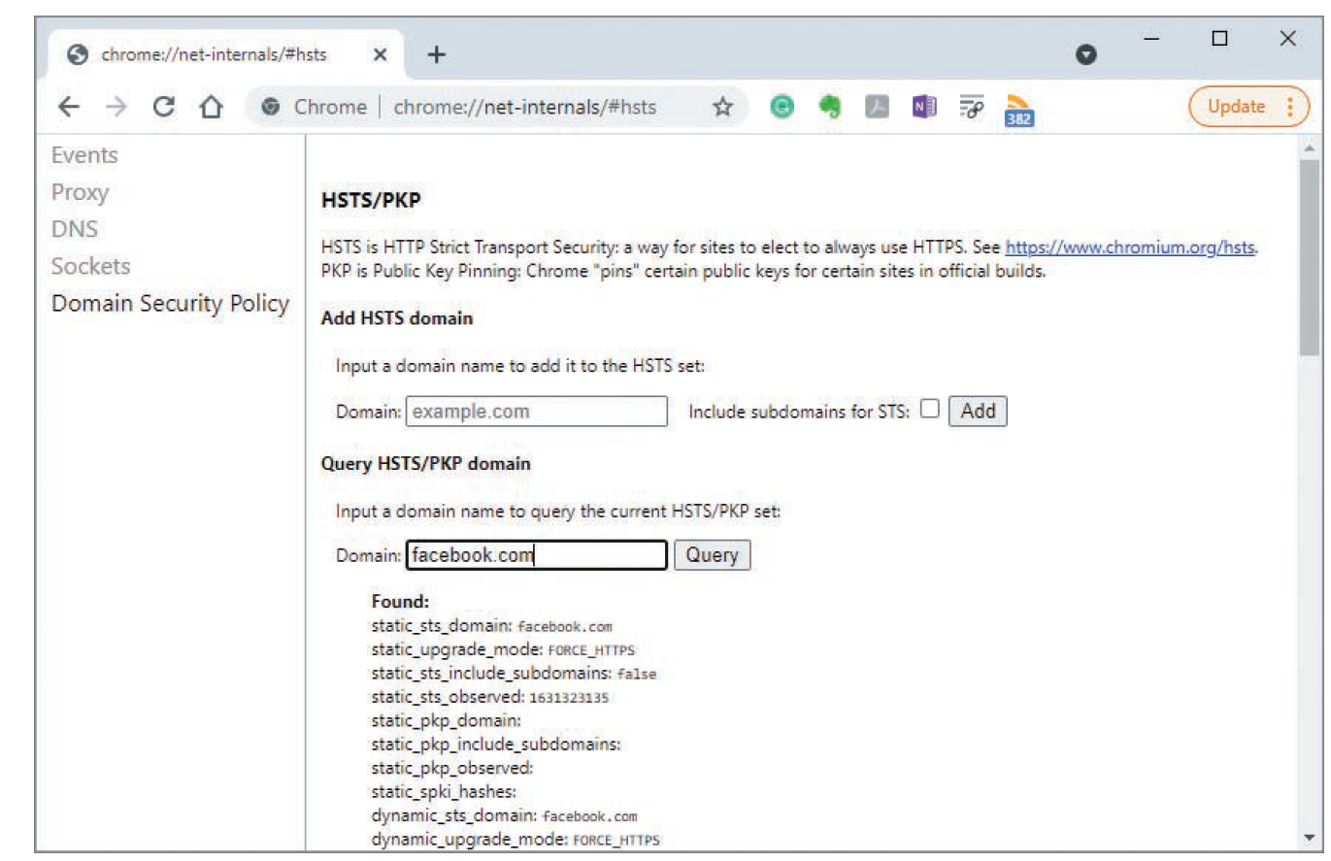
Understanding PKI (5 of 10)
Source: Google Inc.
Figure 12-3 Viewing HSTS/PKP information in Google Chrome

Slide 46
Understanding PKI (6 of 10)
Backing up keys
If keys are destroyed and not backed up, encrypted business-critical information might be irretrievable
Companies typically back up their keys and store them offline in a safe or vault
Microsoft root CA
Includes features in its server OSs for configuring a server as a CA
Instead of using a third-party CA
Example: Using the Add Roles and Features Wizard in Windows Server 2019
Administrator can select Active Directory Certificate Services

Slide 47
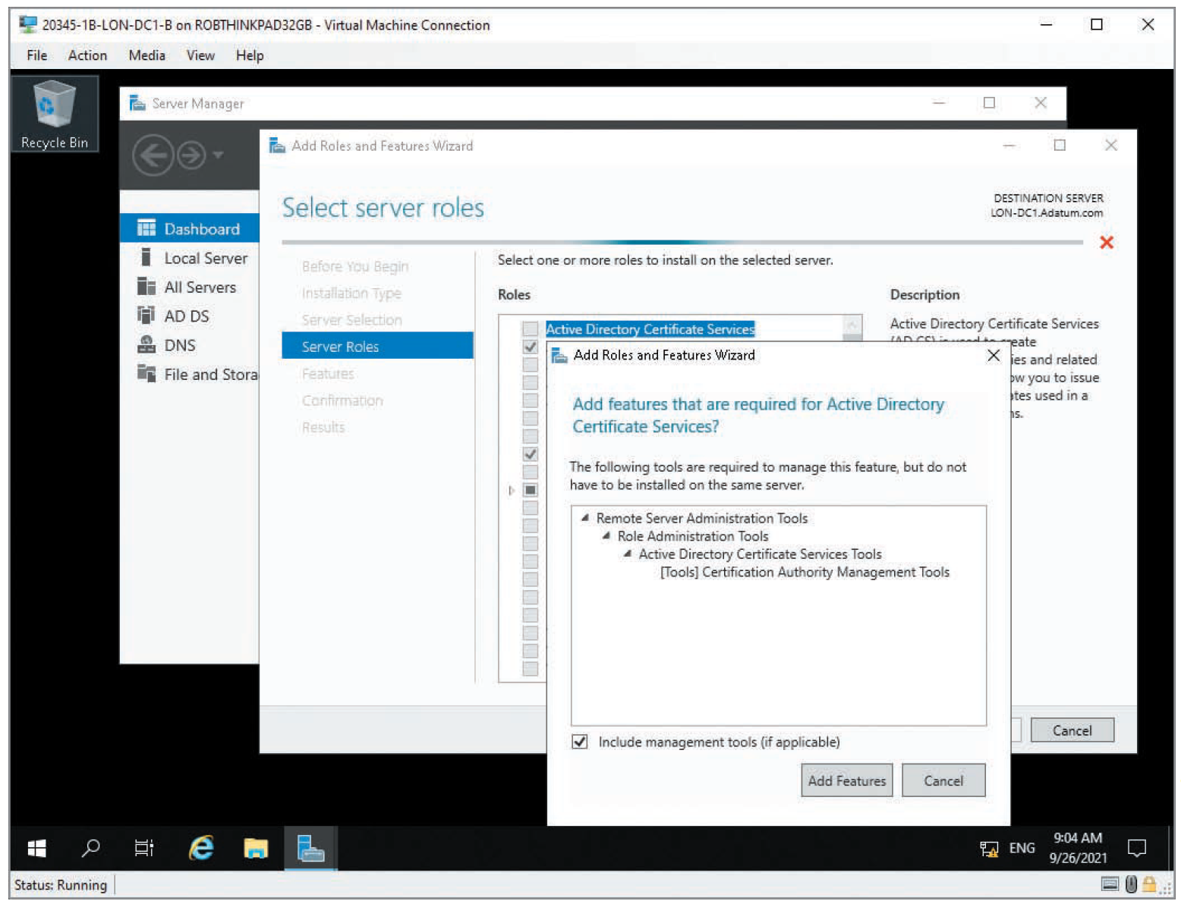
Understanding PKI (7 of 10)
Source: Microsoft
Figure 12-4 Selecting Active Directory Certificate Services

Slide 48
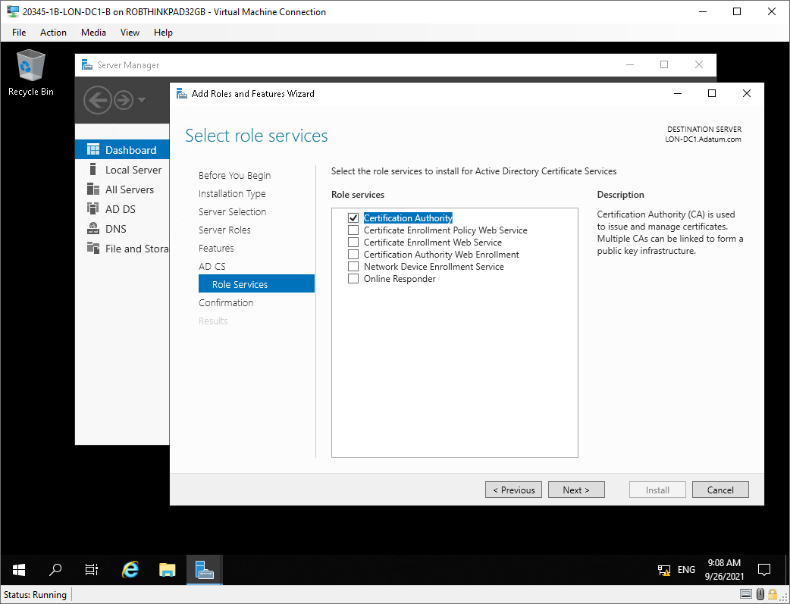
Understanding PKI (8 of 10)
Source: Microsoft
Figure 12-5 Selecting role services to install

Slide 49
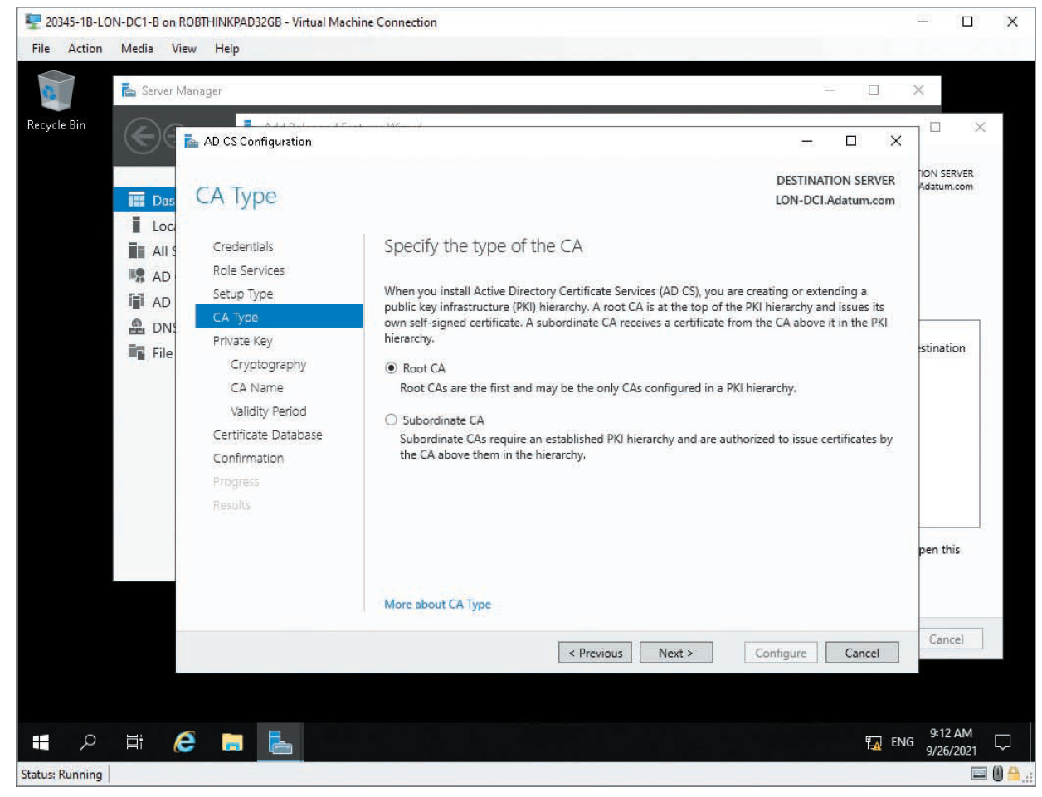
Understanding PKI (9 of 10)
Source: Cengage
Figure 12-6 Specifying a CA type

Slide 50
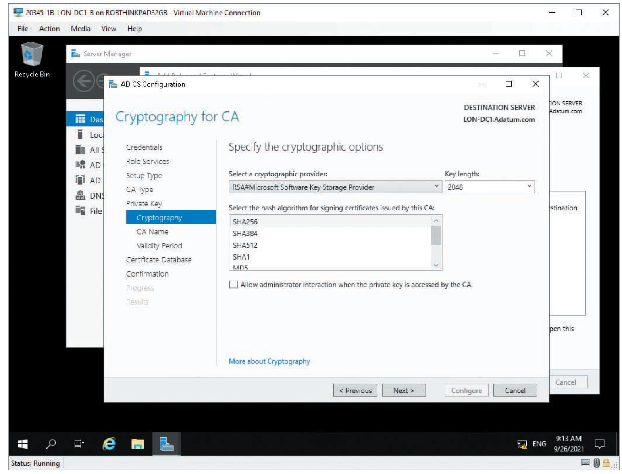
Understanding PKI (10 of 10)
Source: Microsoft Windows
Figure 12-7 Configuring cryptography settings for a CA

Slide 51
Polling Activity 12-1
What is the standard for PKI certificates?
X.500
X.400
X.509
MySQL.409
Notes:
Instructions:
1. Use this activity to solicit student opinions about concepts in the module or to play a game.
2. Go to kahoot.com, or the platform of your preference, and log in or sign up.
3. Create the challenge.
4. Teacher Tip: Turn off the timer to prioritize accuracy or turn on the nickname generator to avoid inappropriate nicknames.
5. Invite players by sharing the link or PIN.
6. This can be done synchronously during class or asynchronously for review or homework.

Slide 52
Polling Activity 12-1: Answer
What is the standard for PKI certificates?
Answer: c. X.509
Each PKI certificate contains a unique serial number and must follow the X.509 standard that describes creating a certificate.

Slide 53
Understanding Cryptography Attacks
Passive attacks
Using tools to eavesdrop
The attacker is only collecting data sent to and from a cryptosystem
Active attacks
Attempt to determine the secret key used to encrypt plaintext
By actively sending input to a cryptosystem
Culprit and general public usually know the algorithm
It’s usually because companies developing encryption algorithms realize that the public might discover vulnerabilities that the company’s programmers missed
Software engineers who develop open-source code products follow this philosophy

Slide 54
Birthday Attack
Old adage that if 23 people are in a room, 50% probability that two will share the same birthday
Birthday attacks
Used to find the same hash value for two different inputs
Used to reveal any mathematical weaknesses in hashing algorithms
SHA-1
Uses a 160-bit digest
Finding a collision for a different message (the same birthday for a different person, in this analogy) would require 2⁶⁰ computations

Slide 55
Mathematical Attack
Properties of the algorithm are attacked by using mathematical computations
Categories:
Ciphertext-only attack
Known plaintext attack
Chosen-plaintext attack
Chosen-ciphertext attack
Side-channel attack

Slide 56
Brute-Force Attack
Attacker tries all possible keys in a keyspace
Example: Attacker uses a password-cracking program
To attempt every possible combination of characters in an effort to break the password hash
Can be launched on any kind of message digest

Slide 57
Man-in-the-Middle Attack
Attackers place themselves between the victim computer and another host computer
They then intercept messages sent from the victim to the host
They pretend to be the host computer

Slide 58
SSL/TLS Downgrade Attack
An attacker intercepts the initial communications between a web server and a web browser
Can force a vulnerable server to insecurely renegotiate the encryption being used down to a weaker cipher
This works because a web server and a web browser must negotiate which cipher will be used to communicate before they begin

Slide 59
Dictionary Attack
Attacker runs a password-cracking program that uses a dictionary of known words as an input file
Most of these input files are available on the Internet and can be downloaded free
Unauthorized password cracking is illegal in most parts of the world, including the United States

Slide 60
Replay Attack
The attacker captures data and attempts to resubmit the captured data
So that the device thinks a legitimate connection is in effect
If the captured data is logon information, attacker could gain access and be authenticated
Many systems have countermeasures to prevent these attacks

Slide 61
Polling Activity 12-2
Intercepting messages destined for another computer and sending back messages while pretending to be the other computer is an example of what type of attack?
Man-in-the-middle
Smurf
Buffer overflow
Mathematical
Notes:
Instructions:
1. Use this activity to solicit student opinions about concepts in the module or to play a game.
2. Go to kahoot.com, or the platform of your preference, and log in or sign up.
3. Create the challenge.
4. Teacher Tip: Turn off the timer to prioritize accuracy or turn on the nickname generator to avoid inappropriate nicknames.
5. Invite players by sharing the link or PIN.
6. This can be done synchronously during class or asynchronously for review or homework.

Slide 62
Polling Activity 12-2: Answer
Intercepting messages destined for another computer and sending back messages while pretending to be the other computer is an example of what type of attack?
Answer: a. Man-in-the-middle
In a man-in-the-middle attack, attackers place themselves between the victim computer and another host computer. They, then intercept messages sent from the victim to the host and pretend to be the host computer.

Slide 63
Understanding Password Cracking (1 of 4)
Password cracking is illegal in the United States
It is legal to crack your own password if you forget it
If a password uses common dictionary words
Most password-cracking programs can use a dictionary file to speed up the process
Brute force is a common method; one way to speed up a brute-force cracking effort is by using a rainbow table
Salt
In cryptographic terms, it is the use of random data alongside plaintext as an input to a hashing function so that the output is unique.
Makes pre-calculated rainbow tables worthless
A graphics processing unit (GPU) greatly exceeds a CPU’s capability to process mathematical calculations

Slide 64
Understanding Password Cracking (2 of 4)
Password cracking
You must first obtain the password file from the system that stores usernames and passwords
Stored in /etc/shadow file for *nix systems
Security Accounts Manager (SAM) file
Windows password hashes are stored in this file
Password-cracking programs used to perform cracking attacks
Hashcat
John the Ripper
0phcrack
EXPECT
L0phtcrack
Pwdump8

Slide 65
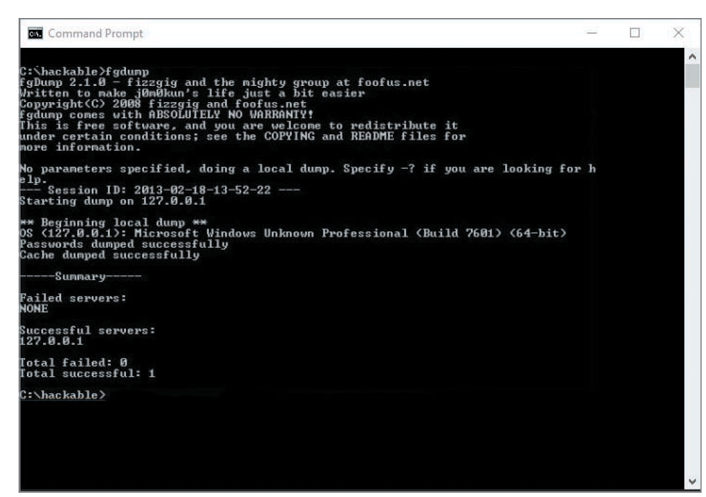
Understanding Password Cracking (3 of 4)
Source: Microsoft Windows
Figure 12-8 Running fgdump

Slide 66
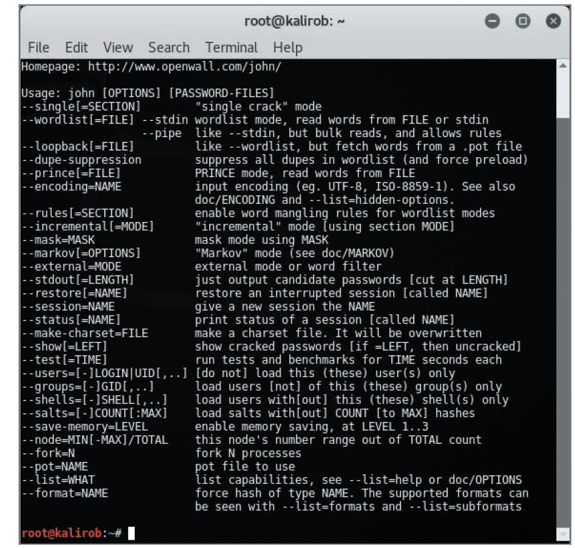
Understanding Password Cracking (4 of 4)
Source: GNU General Public License (GNU GPL)
Figure 12-9 Using John the Ripper parameters

Slide 67
Self-Assessment
Explain the differences between symmetric algorithms and asymmetric algorithms.
Notes:
Instructions:
Use the Self-Assessment question to encourage students to evaluate their progress or goals in the course, as well as determine how they might apply their learning or grow as an individual.

Slide 68
Summary
Now that the lesson has ended, you should be able to:
Summarize the history and principles of cryptography
Describe symmetric and asymmetric encryption algorithms
Explain public key infrastructure (PKI)
Describe possible attacks on cryptosystems
Compare hashing algorithms and how they ensure data integrity

